Slide 1

Predicting Arrhythmias
Xuexin Ren, Jonathan Jui, Ellie Kitanidis

Slide 2
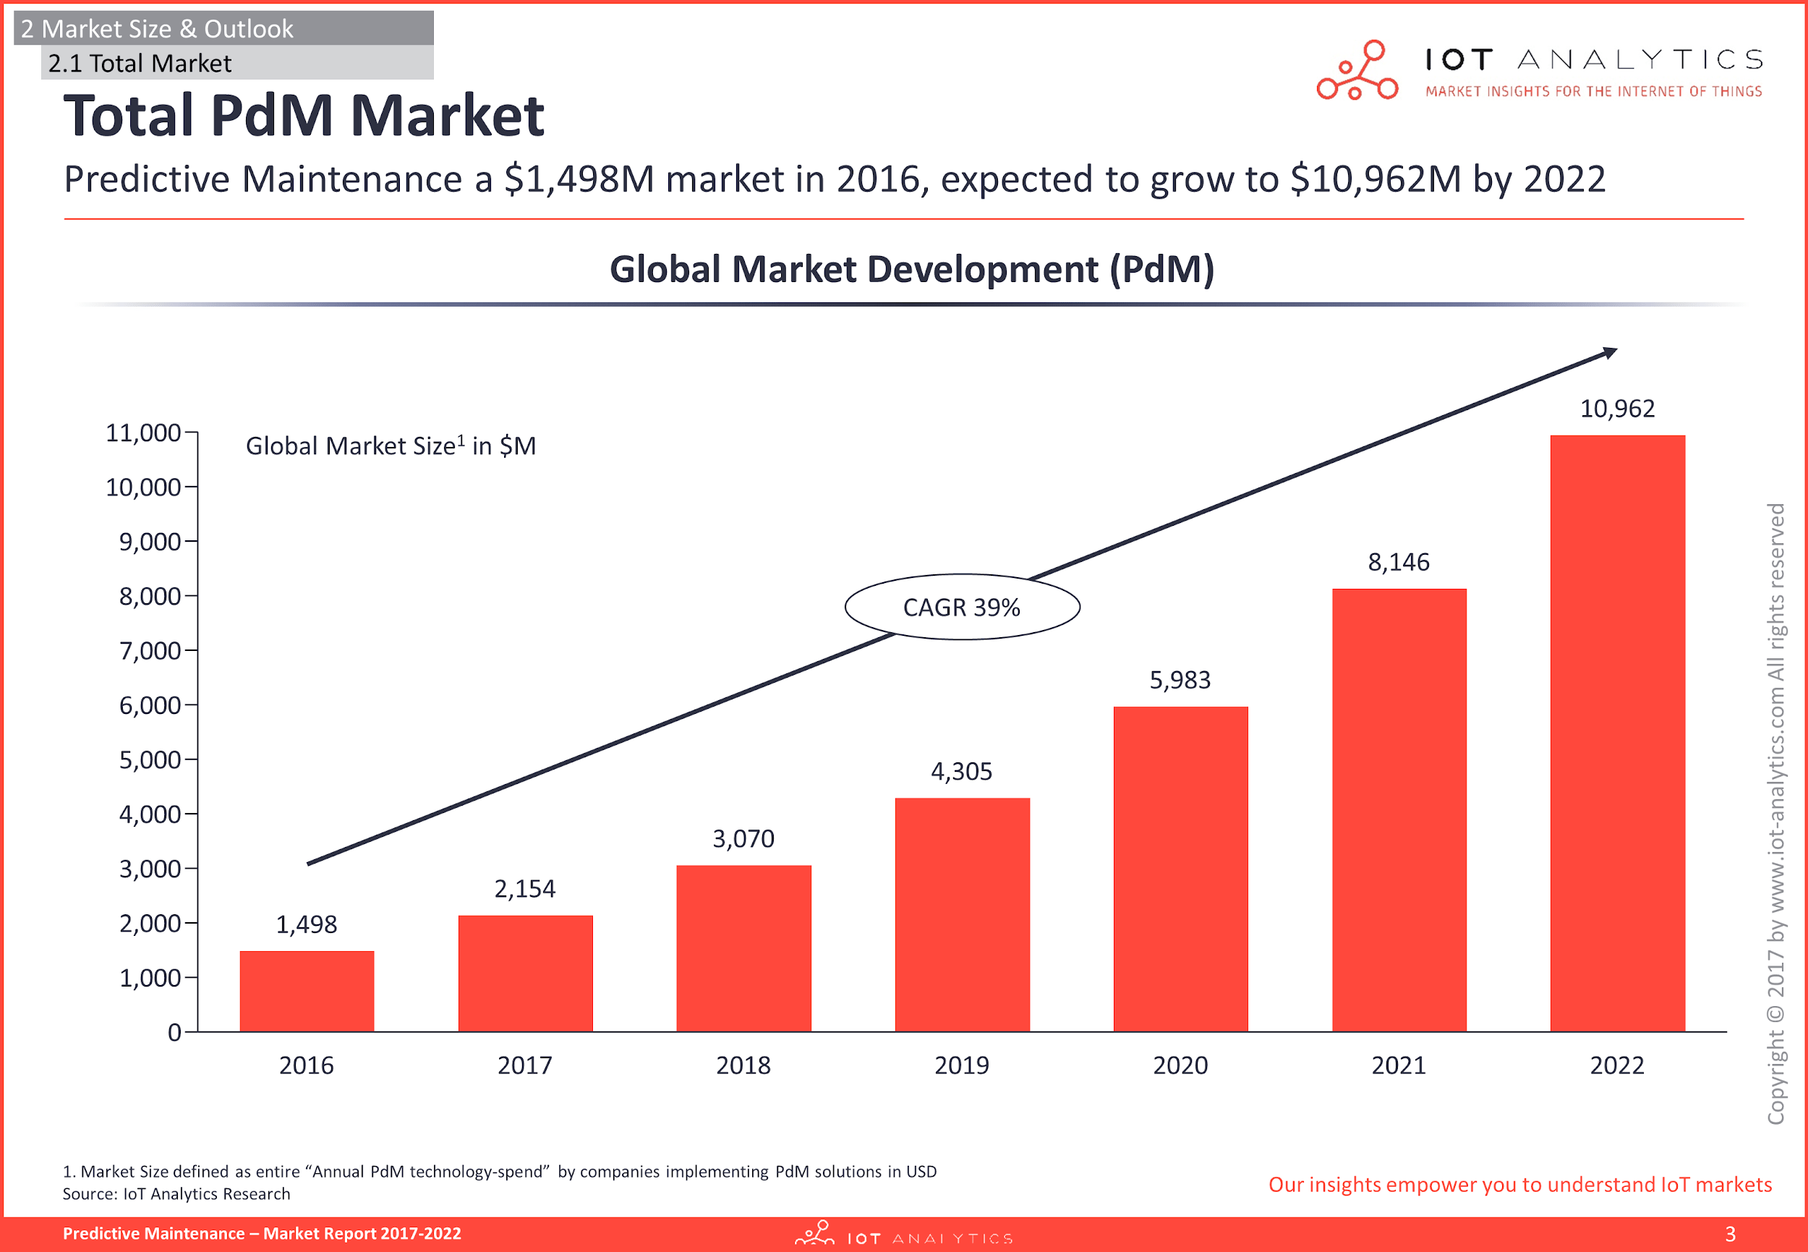
Predictive Maintenance

Slide 3
Predicting Arrhythmias
~350,000 out-of-hospital cardiac arrests per year in U.S., ~90% fatal (Source: American Heart Association, 2018)
MIT-BIH Arrhythmia Database: 48 ECG recordings (30 min each)
Applications of arrhythmia forecasting
Heart monitoring and alerts
Advantage: More data available
Challenge: Have to make more general model

Slide 4
Workflow
Pre-processing
Feature engineering
Machine learning
Demean and scale
Remove noise, smooth signal
Create windows for feature determination, forecast, etc.
Discrete Wavelet Transform
Fourier Transform
Principal Component Analysis
Neural Net
Random Forest
Gradient Boosting Classifier
Logistic Regression

Slide 5
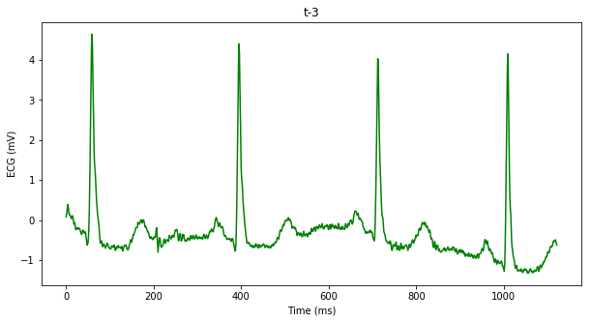
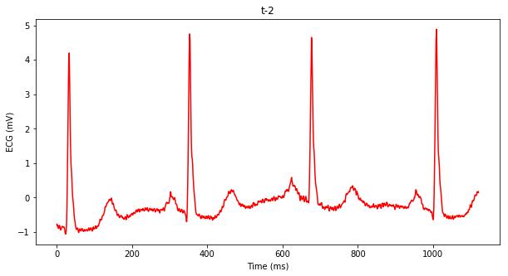
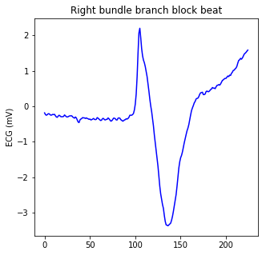
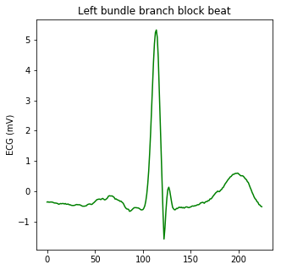
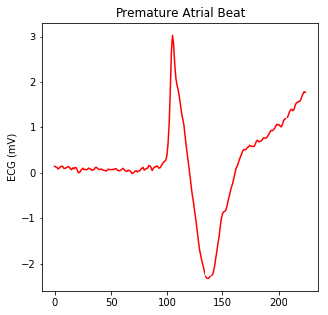
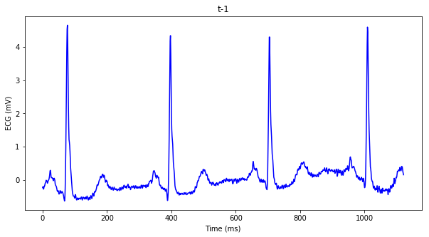
Feature Engineering
Feature Windows
Forecast Point
Forecast Windows
Feature Extraction, Transformation
Binary Labels

Slide 6
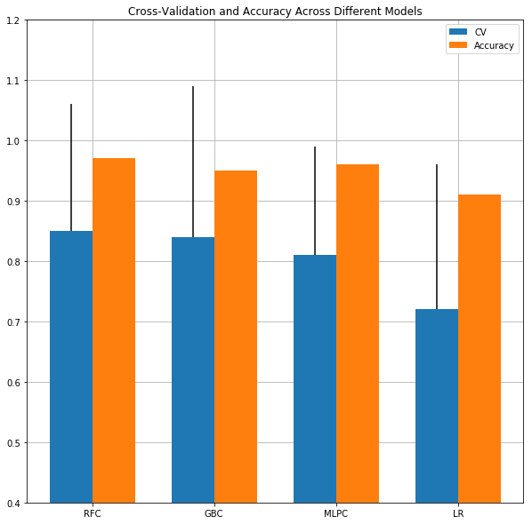
Machine Learning Results
The CV and accuracy scores vary between:
Patient data: randomized vs specific
ECG Channel: MLII, V1, V5
Alignment of heart beats in feature windows
Number of feature windows
Optimising data
Gridsearch parameters
Sample Prediction
Full data 10-fold cross-validation
CV and Accuracy vs Number of feature windows (RF)
 | 1 | 2 | 3 | 4 | 5 | 6
CV Score | 0.83 | 0.84 | 0.85 | 0.84 | 0.86 | 0.84
Accuracy | 0.95 | 0.96 | 0.96 | 0.95 | 0.96 | 0.96
CV vs Peak Alignment (RF)
 | 1 | 2 | 3 | 4 | 5
CV Score | 0.85 | 0.78 | 0.77 | 0.77 | 0.77
RF GB MLP LR

Slide 7
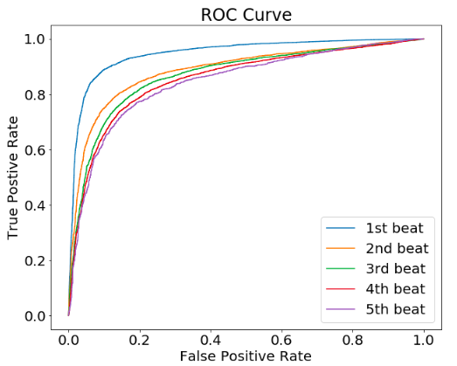
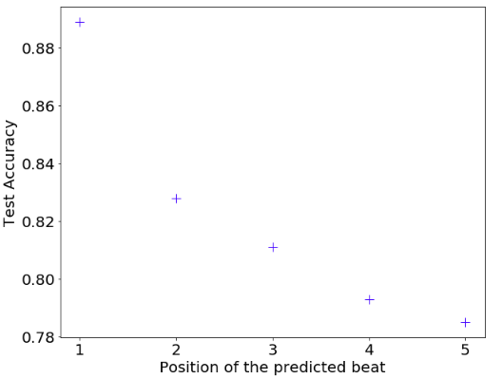
Early prediction

Slide 8
Outlook & Challenges
The classifiers are doing binary classification while the data contains more than 15 different arrhythmic labels
There are very rare types of arrhythmic labels that exist only in a single patient, more data is required
Pacemaker beats are prevalent in the present data and included as arrhythmia
Labeled data is hard to come by, an algorithm that automatically labels heart beats would work well with real-world, unlabeled data
There are different machine learning models to try such as Recurrent Neural Networks and the faster version of Gradient Boost: XGBoost

Slide 9



Team
Ellie Kitanidis
elliek@berkeley.edu
Physics PhD student
Jonathan Jui
jjui@berkeley.edu
Neuroscience PhD student
Xuexin Ren
xxren@berkeley.edu
Applied Science & Technology PhD student

Slide 10
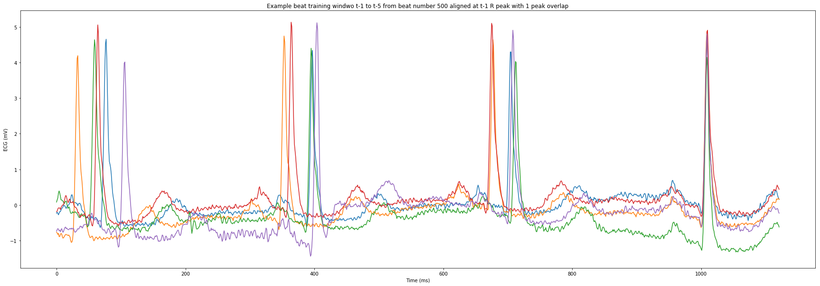
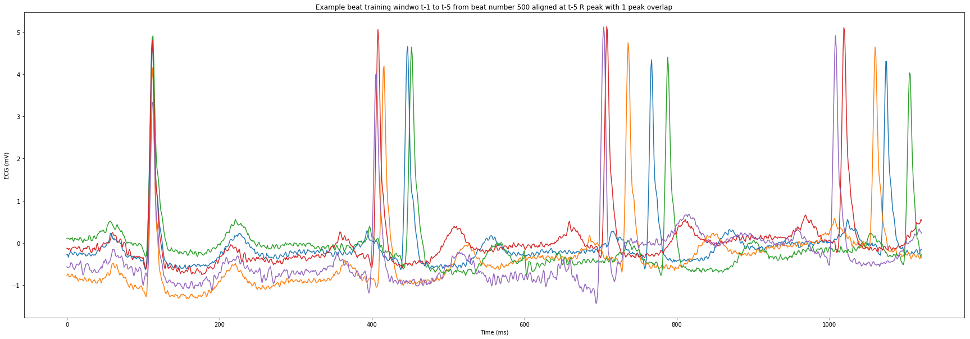
Peak Alignment Example

Slide 11
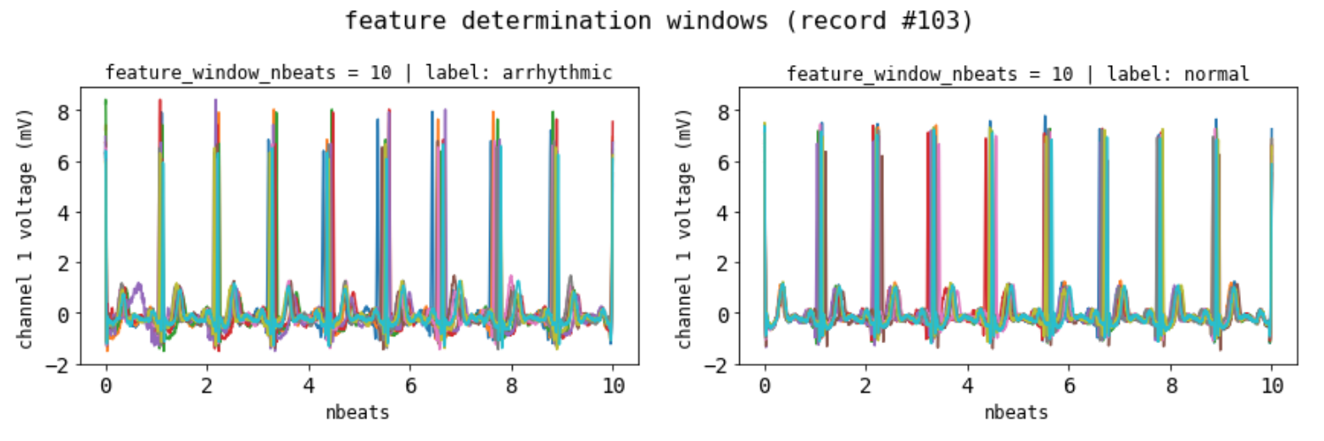
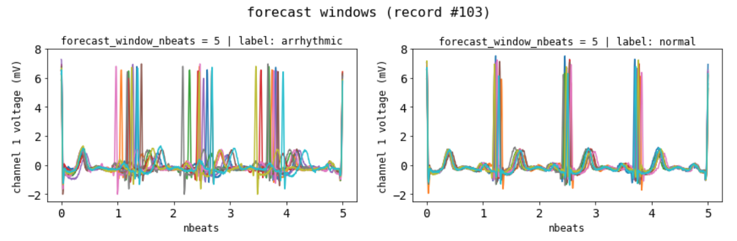
Different Window Types

